Slide 1

Microsoft Technology Center
Security, Compliance & Identity Hackathon
Stefanie Jacobs
Senior Technical Architect
Notes:
<speaker guidance: introduce yourself and the purpose of the meeting>

Slide 2
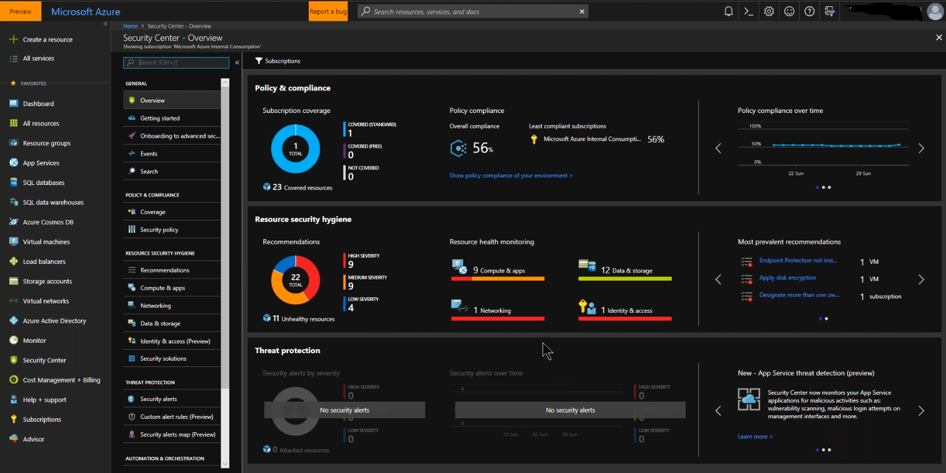
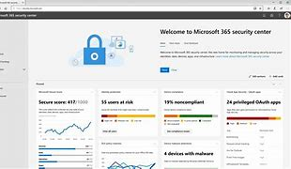

Identify the status quo.
Establish and defend baseline security and compliance configurations for organizations using Microsoft cloud services using Microsoft Security and Compliance tools alongside recommended security best-practices by working through challenges inspired from real-world scenarios.

Slide 3
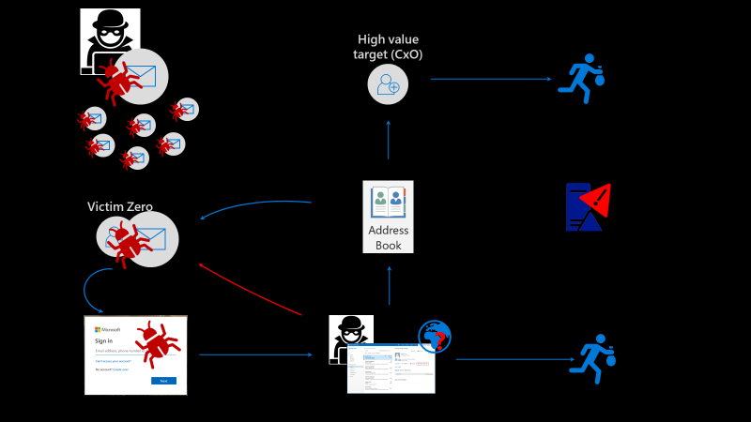

Prepare & roll-out schema.
Analyze and remediate security configurations in a pre-configured Microsoft online organization.
Implement security and compliance policies to enforce regulations required, and mitigate any threats discovered during the assessment.

Slide 4

Refine and look forward.
Get inspired to better protect hybrid cloud environments, leveraging SaaS, IaaS and PaaS solutions.
Gain experience creating policies and procedures to improve your organization’s security and compliance posture.

